Slide 1
FY 2022
Judson Park Improvements
Council Presentation
April 11, 2022

Slide 2
Park Improvement Recommendations
Resurface and restripe tennis court, add pickleball lines for two courts, new windscreens, paint tennis posts and gates
Remove grill and picnic table on north side and add new play feature for older kids - gaga ball
Replace Artificial Turf in 2-5 Year old play area
Paint log structures in 2-5 year old play area and rock slide in 5-12 year old area
Site Furnishings - Upgrade BBQ grill near tennis court, replace picnic tables, replace drinking fountain with bottle filler model
Upgrade park lighting to include solar bollards at entries and LED at deck and Northside.
Repair fencing and paint, deep clean Ipe Deck
Landscape Improvements – Large caliper tree planted tree in 2-5 year old area and updated landscaping beds.

Slide 3
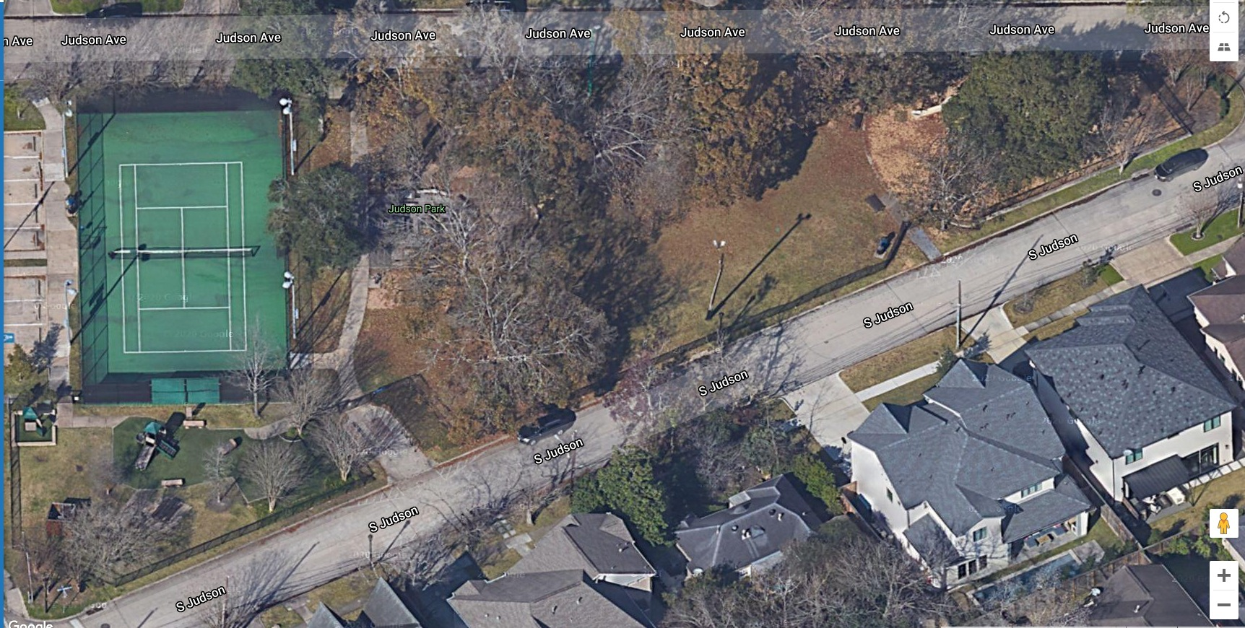
Resurface tennis court, add pickleball lines for two courts, paint tennis fence poles and gates, and new windscreens.

Slide 4
Gaga Ball Pit Area – Location
Remove 1 picnic table and grill in red area and install Gaga Ball Pit.
.

Slide 5
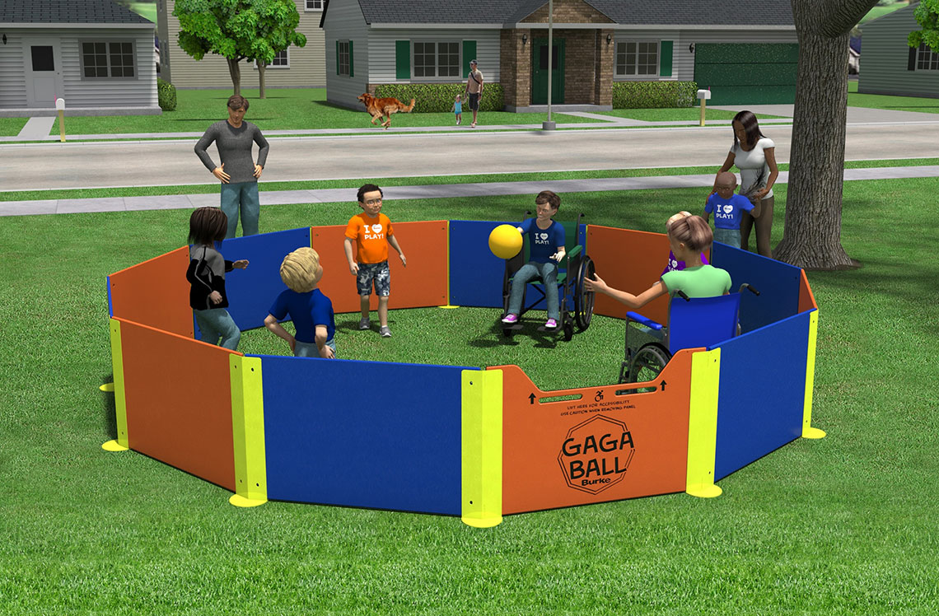
Gaga Ball with ADA Accessible Door

Slide 6
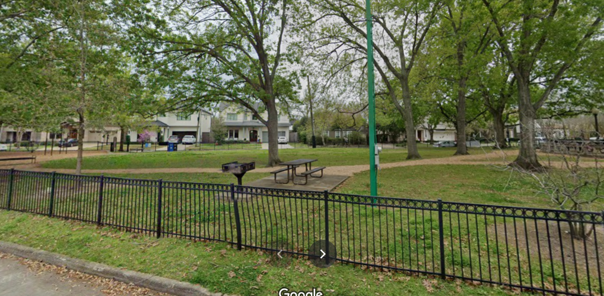
Gaga Ball Location and Green Light Pole to Be Removed

Slide 7
Artificial Turf 2-5 Replacement Area

Slide 8
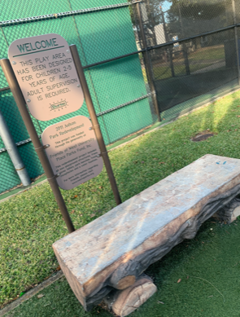
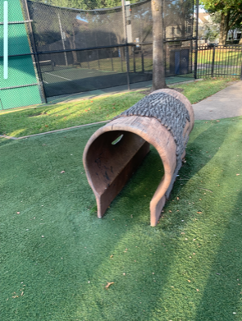
Paint Logs & Rock Play Structures

Slide 9
Clean existing Ipe Decking, New BBQ Grill* and Drinking fountain with Bottle Filler
*Grill Will Be Relocated to Allow for ADA Access

Slide 10
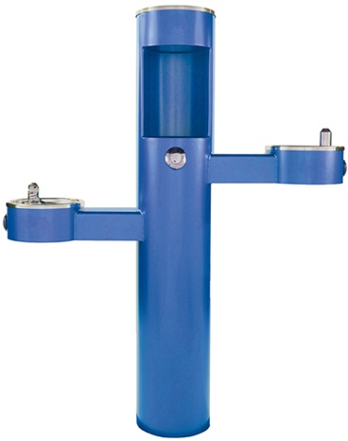
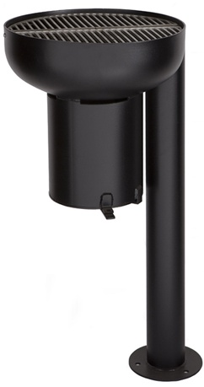
Site Furnishings

Slide 11
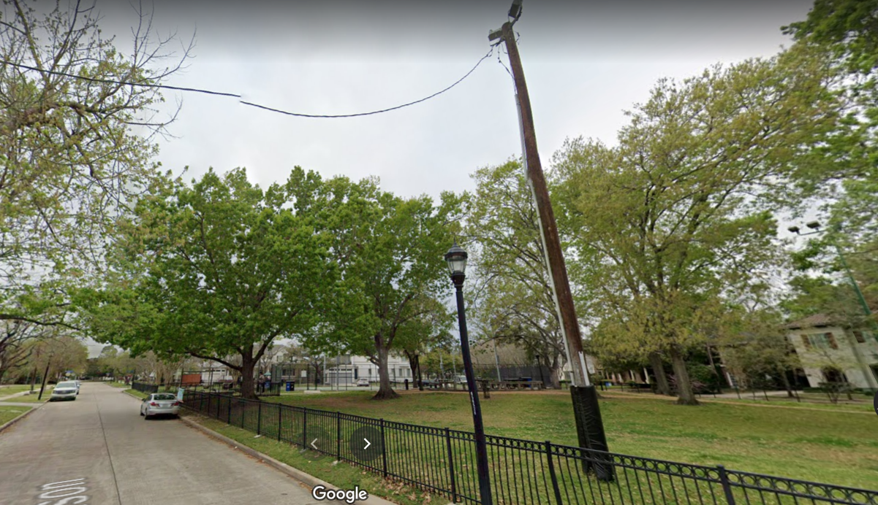
Remove Creosote Pole & Paint/Repair Perimeter Fencing

Slide 12
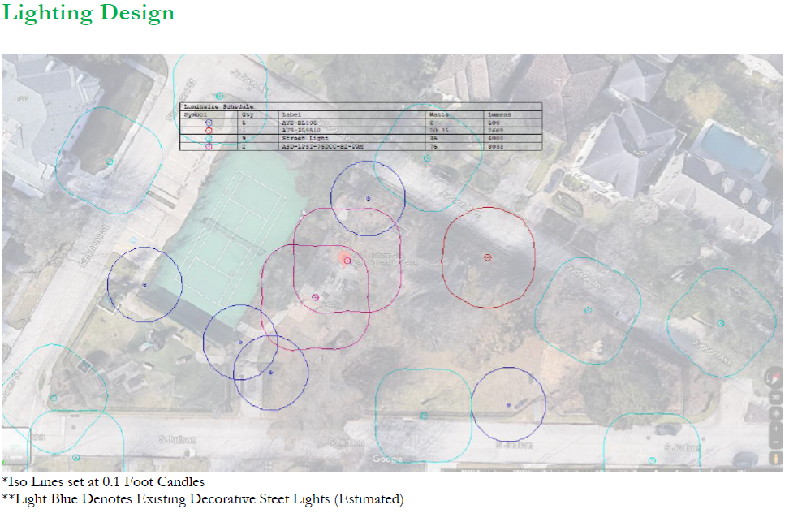
Blue – Solar Bollards and Red – LED Poles
Aqua – Existing Street Lights

Slide 13
Landscape Improvements
New 6” caliper tree
Updated landscape beds

Slide 14
Estimated Budget $125,000 plus 10% contingency
Timeline
1/5/22 – PRB Approved Recommendation
2/14/22 – Present Plan to Council
2/16/22 - Funding Approved by Friends
4/11– Present Recommendation to Council for Approval of Friends Funding
May – Improvements Begin (If not sooner)
August – Improvements Complete
Due to supply chain issues, playground and lighting equipment take longer to arrive after ordering. Estimated wait time is 10 weeks plus installation time.

